Slide 1
Digital Portfolio
STUDENT NAME : VIJAYARANGAN S
REGISTER NO : 20324u09102
NMID : 3DFEBC0188C8EDD9CAE44441BEDAD855
DEPARTMENT : BCA
COLLEGE : DR. MGR.CHOKKALINGAM ARTS
COLLEGE/THIRUVALLUVAR UNIVERSITY
Notes:
V

Slide 2
PROJECT TITLE
𝙎𝙩𝙪𝙙𝙚𝙣𝙩 𝙙𝙞𝙜𝙞𝙩𝙖𝙡 𝙥𝙤𝙧𝙩𝙛𝙤𝙡𝙞𝙤 𝙪𝙨𝙞𝙣𝙜 𝙛𝙧𝙤𝙣𝙩 𝙚𝙣𝙙 𝙙𝙚𝙫𝙚𝙡𝙤𝙥𝙢𝙚𝙣𝙩

Slide 3


AGENDA
Problem Statement
Project Overview
End Users
Tools and Technologies
Portfolio design and Layout
Features and Functionality
Results and Screenshots
Conclusion
Github Link
3/21/2024 Annual Review

Slide 4

PROBLEM STATEMENT
The problem this project addresses is the need for a personal digital portfolio to showcase your skills, projects, and contact information as a college student interested in web development.
As a student passionate about creating interactive and user-friendly websites and small apps, you likely want a professional online presence to: Highlight your technical skills and projects to potential employers, peers, or academic collaborators.
Provide a centralized platform to display your work and make it accessible to others.
Allow potential clients or collaborators to contact you easily.
The current code provides a basic portfolio structure but may face issues such as: Limited content (e.g., only one project listed, no profile picture).
Lack of actual form submission functionality (the form uses a placeholder alert).Potential issues with deployment or accessibility (possibly related to your “webs not finding” comment), such as incorrect file paths, hosting problems, or lack of search engine optimization (SEO).

Slide 5

PROJECT OVERVIEW
This project is a personal portfolio website for Vijayarangan S, a college student passionate about web development.
The website serves as a digital resume to showcase your skills, projects, and contact information.
It includes: A navigation bar with links to Home, About, Projects, and Contact sections. A Home section introducing yourself with your name and status as a college student. An About section describing your passion for creating websites and apps. A Projects section listing a single portfolio website project (with room for expansion).A Contact section with a form for visitors to send messages.
A footer with a copyright notice. The website uses HTML for structure, CSS for styling, and JavaScript for interactivity (smooth scrolling and form submission feedback).
It’s designed to be simple, clean, and user-friendly, with a responsive layout (though it could benefit from additional mobile optimization).

Slide 6

WHO ARE THE END USERS?
The target end users for this portfolio website include: Potential Employers: Hiring managers or recruiters in the tech industry looking for web development talent.
Academic Peers or Professors: Classmates or instructors who may collaborate on projects or evaluate your work.
Clients or Freelance Opportunities: Individuals or small businesses seeking a developer for small apps or websites.
General Visitors: Anyone interested in your work, such as peers, mentors, or open-source contributors. These users expect a professional, easy-to-navigate website that clearly presents your skills, projects, and contact details. Accessibility and responsiveness are important to ensure the site is usable across devices (e.g., desktops, tablets, phones).

Slide 7

TOOLS AND TECHNIQUES
The tools and technologies used in this project, based on the provided code, are:HTML5: For structuring the website (semantic elements like <header>, <nav>, <section>, <footer>).
CSS3: For styling, including Flexbox for layout (e.g., .nav-links, .about-container), transitions (e.g., hover effects), and responsive design (via the viewport meta tag).
JavaScript (Vanilla): For interactivity, specifically: Smooth scrolling for navigation links using scrollIntoView({ behavior: 'smooth' }).
A placeholder form submission handler with an alert.
Text Editor/IDE: Likely used to write the code (e.g., VS Code, Sublime Text, though not specified).

Slide 8
Browser Developer Tools: For testing and debugging the site locally.Potential Hosting Platforms (not specified but relevant for deployment): GitHub Pages, Netlify, or Vercel could be used to host the site.
If you’re using additional tools (e.g., Git for version control, a local server for testing), please confirm, and I can include them.

Slide 9
POTFOLIO DESIGN AND LAYOUT
Header - Fixed navigation bar with logo (“MyPortfolio”) and links (Home, About, Projects, Contact). - Black background (#111), white text, blue hover effects (#0f62fe). - Flexbox for horizontal logo and nav link alignment.
Home Section - Centered text with blue gradient background (#0f62fe to #0047ab). - Displays name (<h1>) and description (“College student”).
About Section - Heading and paragraph in a Flexbox container (.about-container). - .profile-pic CSS defined but no image in HTML. - Lacks engaging visuals (e.g., images, icons).
Projects Section - Single project in a card (.project-item) with white background, shadow, and hover scaling. - Minimal content: vague description (“Small sapps/Web site/Web pages”).
Contact Section- Form with name, email, message fields, styled with vertical Flexbox. - Blue submit button with hover effect.
9

Slide 10
Footer - Centered copyright text, styled like the header.
Overall Layout - Vertically stacked sections with consistent padding (50px 20px). - .main-wrapper CSS defined but unused in HTML. - Partial responsive design with viewport meta tag, no media queries for mobile.
Improvement Suggestions - Add profile picture to About section for .profile-pic CSS. - Use or remove .main-wrapper class. - Add media queries for mobile (e.g., vertical .about-container stacking). - Enhance visuals with images, icons, gradients, or borders.

Slide 11
FEATURES AND FUNCTIONALITY
The website includes the following features and functionality:Navigation:Smooth scrolling to sections when clicking nav links, implemented via JavaScript (scrollIntoView).
Links to Home, About, Projects, and Contact sections. Contact Form: A form with name, email, and message fields, marked as required for basic validation.
JavaScript prevents default form submission and shows an alert (“Thank you! Your message has been sent.”).
No actual backend integration for sending messages (placeholder functionality).Hover Effects: Navigation links change color on hover (#0f62fe).
Project items scale slightly on hover (transform: scale(1.02)).The submit button darkens on hover (#0047ab).Responsive Design: Basic responsiveness via the viewport meta tag and flexible layouts (e.g., Flexbox in .nav-links and .about-container).
Limited mobile optimization (no media queries).Potential Enhancements: Integrate a backend service (e.g., Form spree, Emails) for the contact form to send emails.
Add more projects with images, descriptions, and links (e.g., to GitHub or live demos).Include a “Back to Top” button for better navigation. Add animations (e.g., fade-in effects for sections) using CSS or JavaScript libraries like AOS.

Slide 12
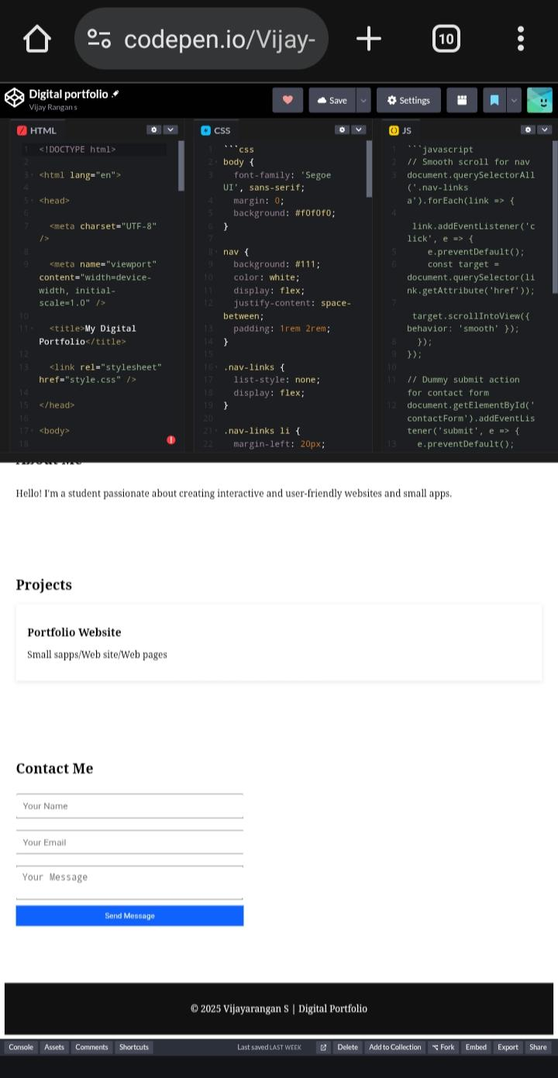
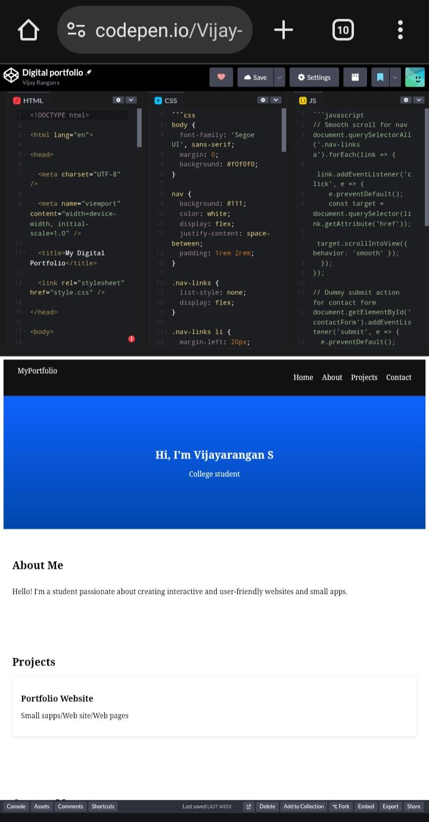

RESULTS AND SCREENSHOTS
3/21/2024 Annual Review
12

Slide 13
CONCLUSION
This portfolio website is a solid starting point for showcasing your skills as a college student in web development.
It demonstrates basic proficiency in HTML, CSS, and JavaScript, with a clean design and functional navigation. However, it can be improved by: Adding more projects with detailed descriptions and visuals. Implementing actual form submission functionality. Enhancing responsiveness for mobile devices.
Fixing unused CSS (e.g., .main-wrapper, .profile-pic) by adding corresponding HTML or removing the styles.
If the “webs not finding” issue refers to deployment or accessibility problems, addressing file paths, hosting, or SEO will resolve it.
13

Slide 14

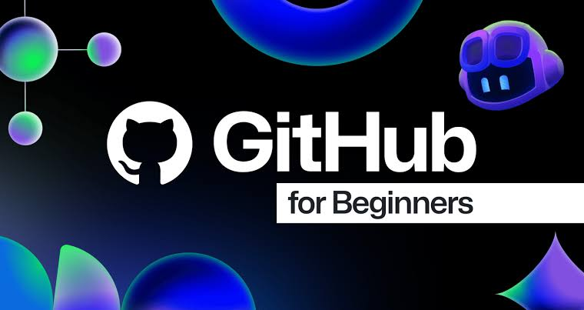


GitHub Link
This is a my GitHub Link
https://vijayarangan20324u09102-prog.github.io/Digital-portfolio-/

